Slide 1
Tutorial 2 notes

Slide 2
Q1

Slide 3
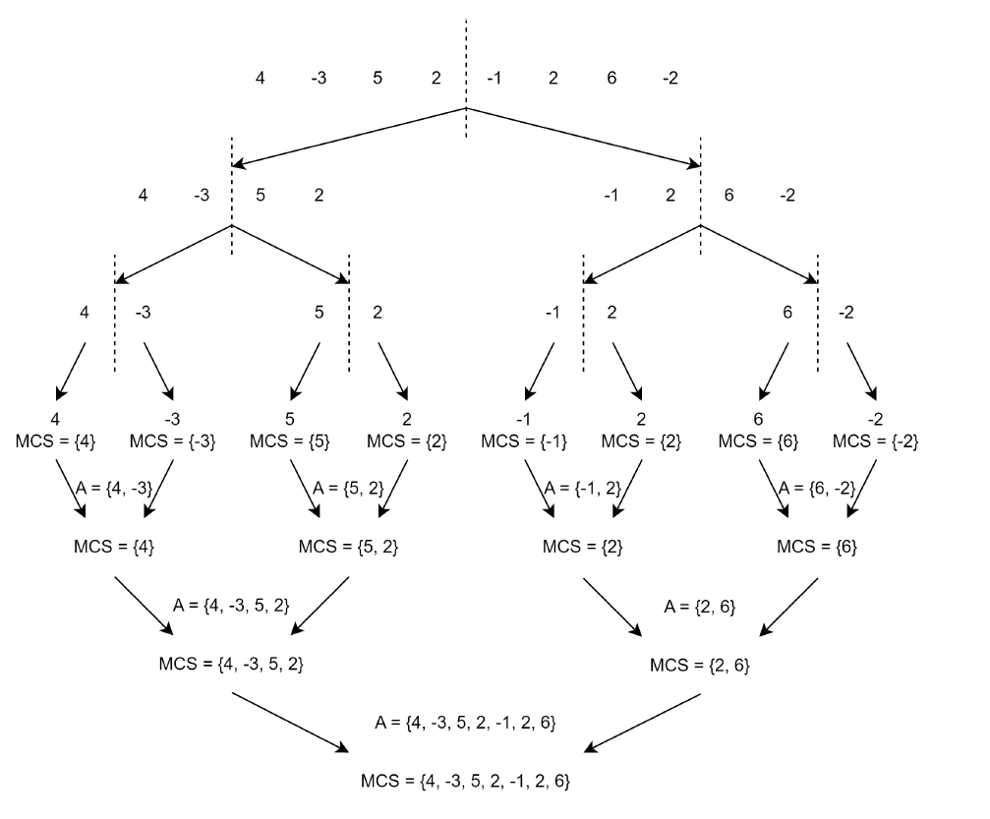

Slide 4
Q2

Slide 5
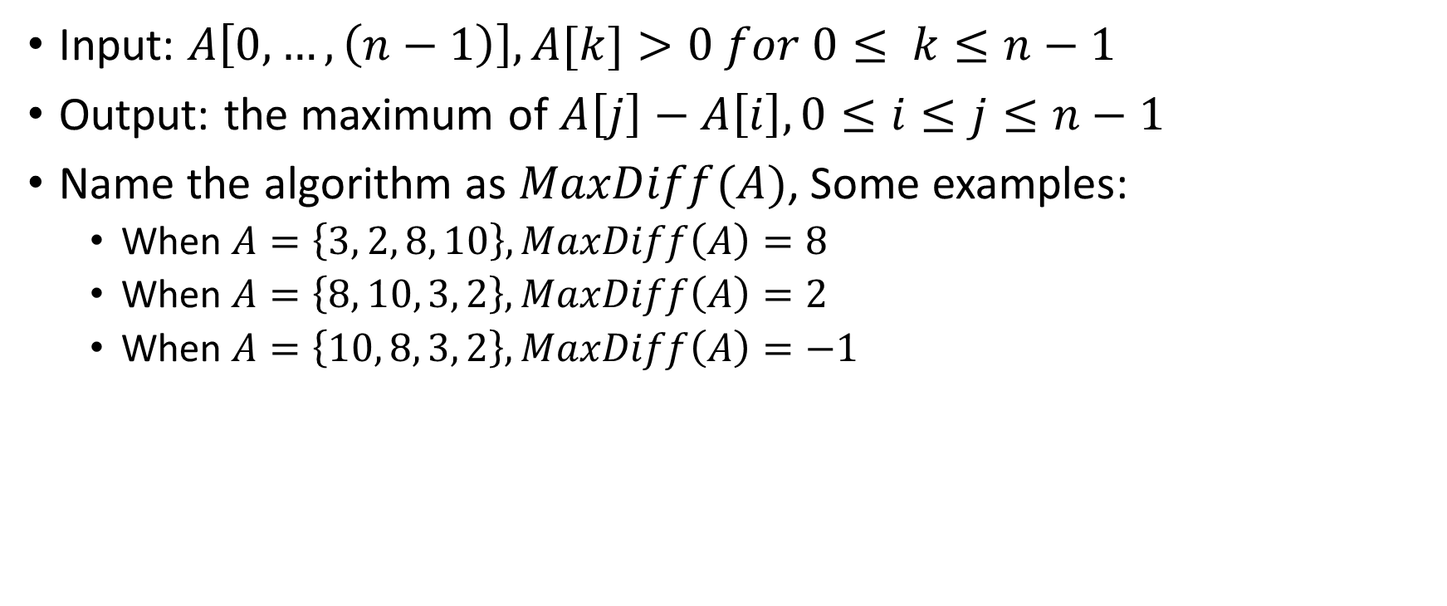
Analysis
Input: $A\left[0,…,\left(n−1\right)\right], A[k]>0 for 0≤ k≤n−1$
Output: the maximum of $A\left[j\right]−A\left[i\right], 0≤i≤j≤n−1$
Name the algorithm as $MaxDiff(A)$, Some examples:
When $A=\left\{3, 2, 8, 10\right\}, MaxDiff\left(A\right)=8$
When $A=\left\{8, 10, 3, 2\right\}, MaxDiff\left(A\right)=2$
When $A=\left\{10, 8, 3, 2\right\}, MaxDiff\left(A\right)=−1$

Slide 6
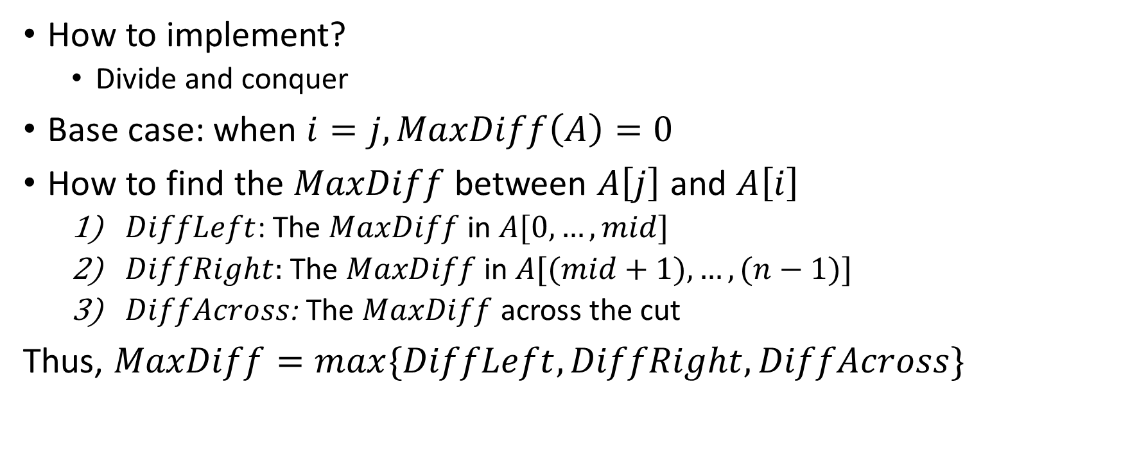
Analysis
How to implement?
Divide and conquer
Base case: when $i=j, MaxDiff\left(A\right)=0$
How to find the $MaxDiff$ between $A\left[j\right]$ and $A\left[i\right]$
$DiffLeft$: The $MaxDiff$ in $A[0, …, mid]$
$DiffRight:$ The $MaxDiff$ in $A[(mid+1), …, (n−1)]$
$DiffAcross$: The $MaxDiff$ across the cut
Thus, $MaxDiff=max\{DiffLeft, DiffRight,DiffAcross\}$

Slide 7

Analysis
How to find $DiffAcross$?
Find the minimum element, $min⁡$, in left sub-array ;
Find the maximum element, $max⁡$, in the right sub-array;
Then, $DiffAcross=max−min$

Slide 8






3 2 8 10
3 2
8 10
3
2
8
10
$$A=\{3,2\}$$
$$A=\{8,10\}$$
$$diffL=0$$
$$diffR=0$$
$$diffL=0$$
$$diffR=0$$
$$Min=3,Max=2$$
$$diffA=−1$$
$$Min=8,Max=10$$
$$diffA=2$$
$$maxDiff=\max\left\{diffL,diffR,diffA\right\}=0$$
$$maxDiff=\max\left\{diffL,diffR,diffA\right\}=2$$
$$A=\{3,2,8,10\}$$
$$Min=2,Max=10$$
$$diffA=8$$
$$maxDiff=\max\left\{diffL,diffR,diffA\right\}=max⁡\{0,2,8\}=8$$

Slide 9
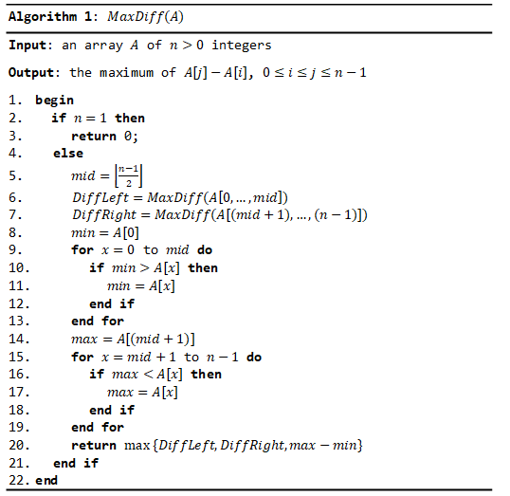
Pseudo code

Slide 10
Q3

Slide 11

Think
Why we compute $ac+\left(\left(a+b\right)\left(c+d\right)−ac−bd\right)i−bd$ instead of $ac+\left(ad+bc\right)i−bd$?

